Slide 1
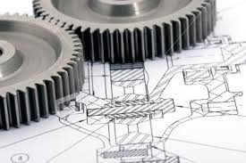
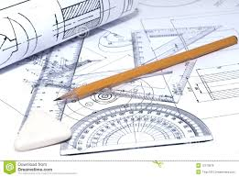
ENGINEERING GRAPHICS
MEC103

Slide 2
Course details
LTP – 2 2 0 [Two lectures/Two Tutorials/week]
Credit:4.0

Slide 3
Syllabus
MEC103:ENGINEERING GRAPHICS
L:2 T:2 P:0
Course Objectives:
•To inculcate the knowledge of basic geometries, geometric tools, shapes and procedures used for engineering drawings.
•To have detailed conceptual knowledge about the dimensioning, specifications and conventions.
• To have an understanding of different concepts of theory of projections, development, sectioning and 3-D representations of objects. .

Slide 4
Syllabus
Unit I
Introduction to Engineering Drawing : Principles of Engineering Graphics and their significance, Drawing instruments.
Lettering: Letter Writing in vertical Gothic letters using single stroke.
Dimensioning.
Line Types:Different types of lines used in engineering drawing.
Scales- Plain and diagonal scale.
Unit II
Projection of Points & Lines:Projection of Points, Projection of line perpendicular to HP, Projection of line perpendicular to VP, Projection of line parallel to HP and VP, Projection of line inclined to HP and parallel to VP, Projection of line inclined to VP and parallel to HP, Horizontal and Vertical traces of line.

Slide 5
Syllabus
Unit III
Orthographic Projections: Method of obtaining Orthographic Projections in First angle and third angle projection., Principles of orthographic projections
Unit IV
Sectional views : Sectioning webs and ribs, Importance of sectioning, Types of section including full section, offset section and half section.
Unit V
Isometric Projections : Principles of Isometric Projections, Isometric Scale, Terminology, Isometric view of step, inclined, oblique, cylindrical blocks, Isometric Dimensioning.
Unit VI
Development of Surfaces: Methods of development, Parallel line development of cylinder and prism, Radial line development of cone and pyramid.

Slide 6

Course Assessment Model
Marks break up*
Attendance 5
6 Best grid sheet out of 7 25
MTE 20
ETE 50
Total 100
  3 grid sheet before MTE 4 after MTE

Slide 7
Syllabus
Text Books:
ENGINEERING DRAWING WITH AN INTRODUCTION TO AUTOCAD by DHANANJAY A JOLHE, MC GRAW HILL, 4th Edition, (2010)
References:
1. ENGINEERING DRAWING by M.B.SHAH,BC RANA, PEARSON EDUCATION, INC., 3rd Edition, (2012)
2. ENGINEERING DRAWING by N.D. BHAT & M. PANCHAL, CHAROTAR PUBLISHING HOUSE PVT LTD, 1st Edition, (2008)

